Slide 1
Forsyth BYOT in the News

Slide 2
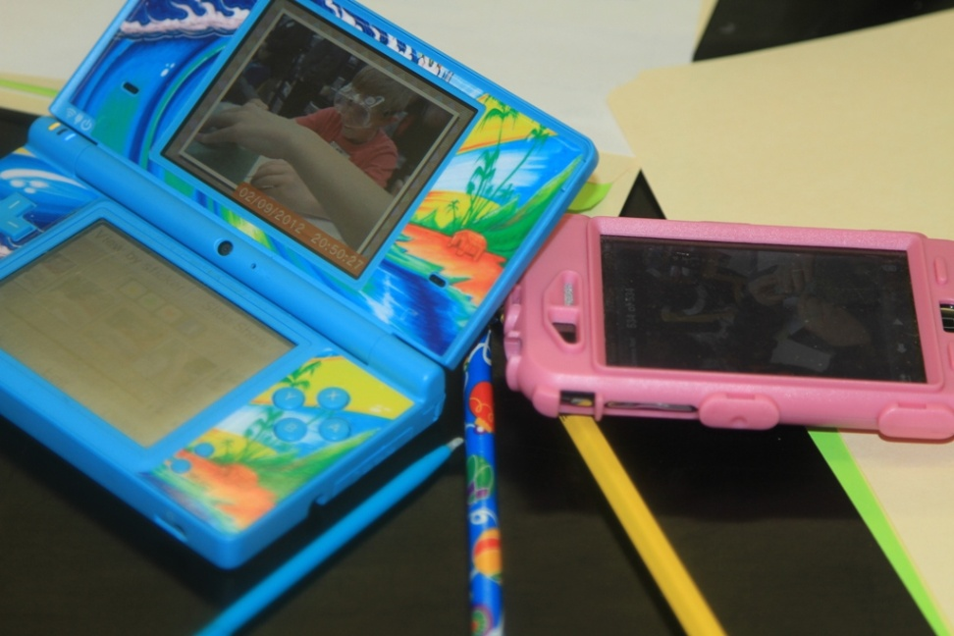
Why BYOT?
Increases student engagement
Improves student organization (using tools found on devices)
Provides real world experience with technology
Ensures students have skills needed to excel

Slide 3
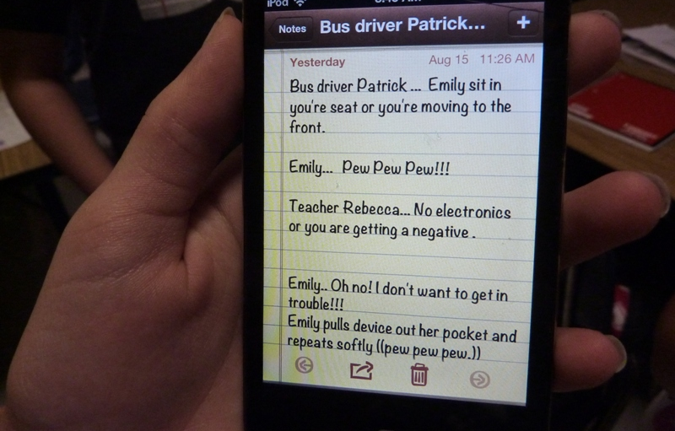
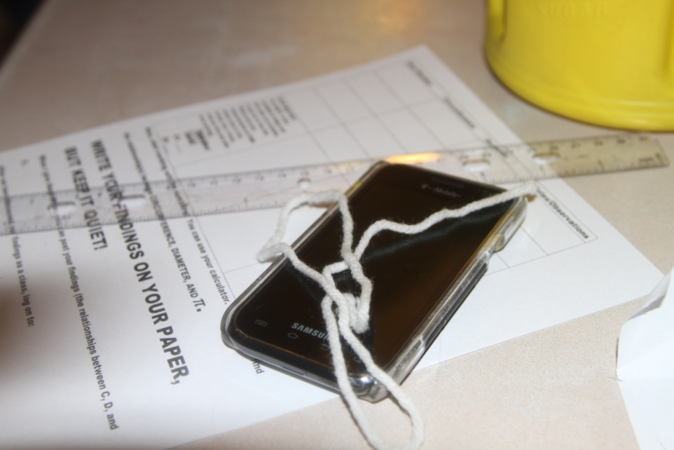
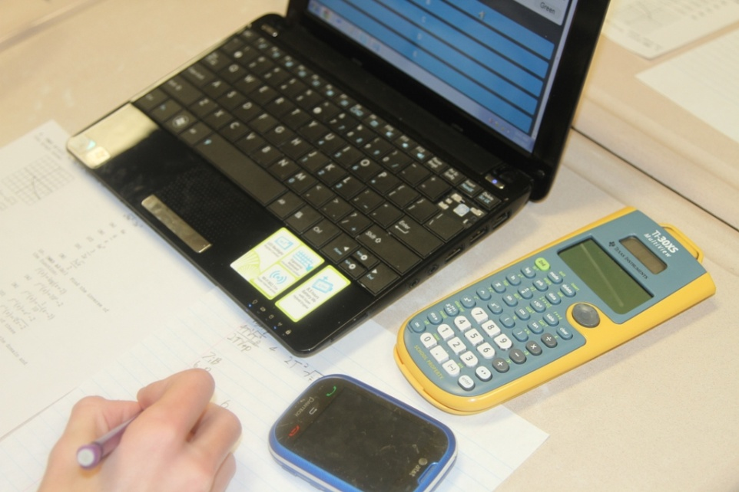
BYOT is about instruction, increasing engagement, and learning in the 21st Century

Slide 4
What is TRUST?
T hink about privacy before posting
R ecognize others' work and ideas
U nleash learning with technology
S tand up to inappropriate use
T reat myself and others with respect
Students must follow county’s Responsible Use Procedures. Each grade level will be educated on this.
Below is our “TRUST” video that is being shown to all classes.
TRUST Student Presentation

Slide 5
What Technologies?
Laptops
Netbooks
(iOS devices) iPods, iPhones, iPads
Smart Phones (Android, etc.)
Kindles
Tablets
Remember… It’s not about the technology~
It’s about the learning!

Slide 6
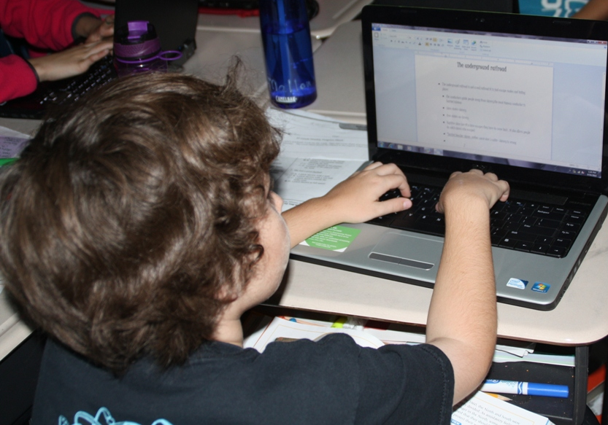
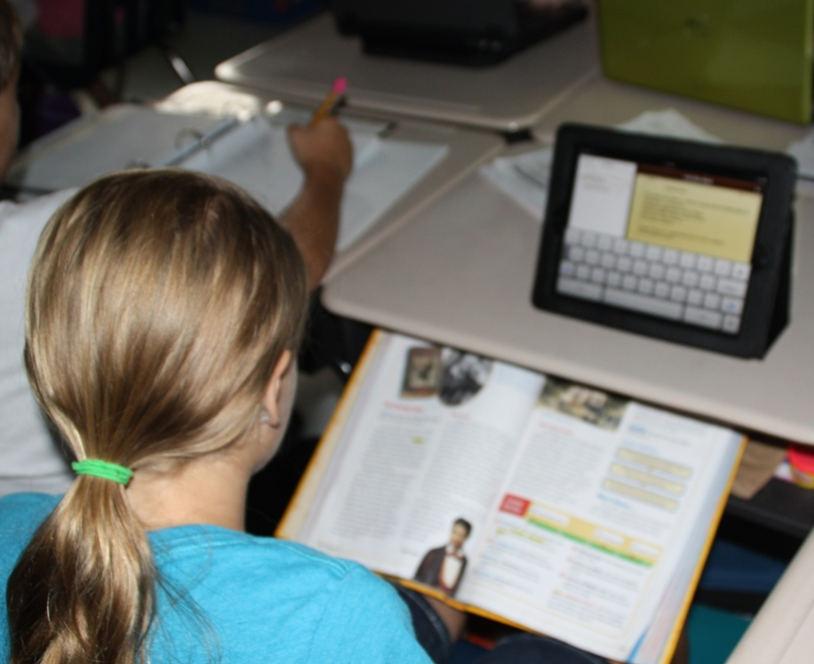
B.Y.O.T. in Action

Slide 7
What BYOT Isn’t
Playing games for the sake of playing games
(Always ask yourself- What standard does this address?)
Busy work
Students checking email and texting friends about random things
A reward activity
Isolated Activity- BYOT should be seamlessly integrated into the curriculum.

Slide 8
Logistics
Students are responsible for their device security and damages. Classrooms will be locked when teachers and students are not in the room.
Internet access will be through school BYOT wireless network with school filters in place.
Students will complete a B.Y.O.T. Student Agreement detailing expectations and responsibilities.

Slide 9
Logistics
Students will need to print projects at home (if they want to print something from their device).
If a student wants to email the teacher their project, then they will need to do this from home. (Most ways to do this at school may be blocked).
It is important that students remember to plug in and charge their devices fully before bringing them into school. We have very limited access to charging devices at school. (Most of our plugs are used for school issued equipment),

